Slide 1

Appliances Energy Prediction
Sri Ram
221FA14003
BIOINFORMATICS-III

Slide 2
About my Dataset
The dataset consists of energy-related data collected over time. It includes the following columns:
date: Timestamp of the observation.
Appliances: Energy consumption of appliances (in Wh).
lights: Energy consumption of lights (in Wh).
T1 - T9: Temperature readings from various indoor locations.
RH_1 - RH_9: Relative humidity readings from various indoor locations.
T_out: Outdoor temperature.
Press_mm_hg: Atmospheric pressure in mmHg.
RH_out: Outdoor relative humidity.
Windspeed: Wind speed (m/s).
Visibility: Outdoor visibility (km).
Tdewpoint: Dew point temperature.
rv1, rv2: Random variables.Potential Analysis and Visualizations:

Slide 3
Output Of sales prediction using Python script :
This plot shows the relationship between Appliances Energy Consumption (in Wh) on the vertical axis and Outdoor Temperature (in °C) on the horizontal axis, with a linear regression line plotted on top of the data points.
Key Elements:
Scatter Plot (Blue Dots):
Each blue dot represents a data point that corresponds to a specific outdoor temperature and the appliances' energy consumption at that temperature.
The points are dispersed over a wide range of energy consumption values, with a noticeable clustering near the bottom of the plot (low energy consumption values).
Linear Regression Line (Red Line):
The red line represents the best-fit linear regression line that tries to model the relationship between the outdoor temperature and appliances' energy consumption.
The line has a slight upward slope, indicating a weak positive correlation between the two variables (i.e., as the outdoor temperature increases, energy consumption tends to increase slightly).

Slide 4
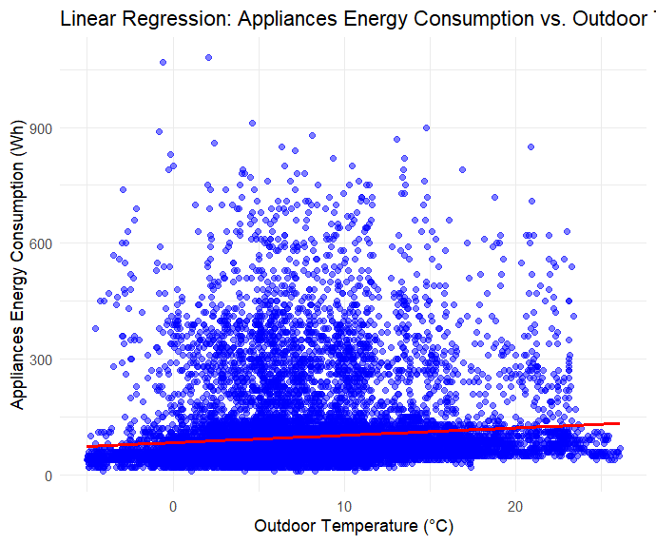

Slide 5
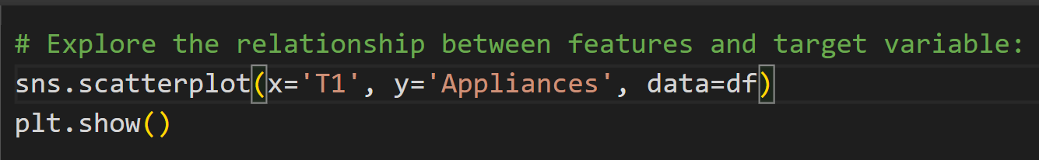
Relation between features and target variables
The provided code uses Seaborn (sns) and Matplotlib (plt) to visualize the relationship between a feature (T1) and the target variable (Appliances) in a DataFrame (df).
sns.scatterplot(x='T1', y='Appliances', data=df):
This line creates a scatter plot using the scatterplot function from the Seaborn library.
x='T1': The T1 column from the DataFrame (df) is plotted on the x-axis. This column might represent a feature, possibly indoor temperature.
y='Appliances': The Appliances column from df is plotted on the y-axis, representing the target variable (likely the energy consumption of appliances in Wh).
data=df: Specifies that the data comes from a pandas DataFrame df.

Slide 6
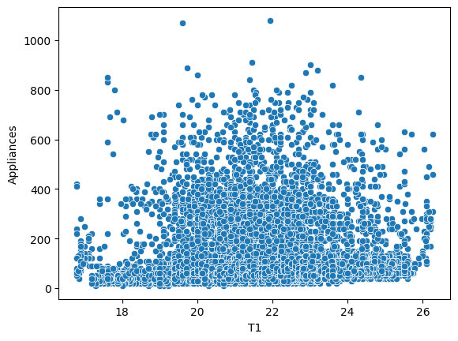

Slide 7

Conclusion
The analysis demonstrates how both R and Python can be utilized for accurate energy prediction using linear regression models. The results reveal a positive correlation between appliances and energy consumption, with the linear models capturing this relationship effectively. However, minor discrepancies in predictions indicate that the model can be further optimized. Performance metrics like Mean Squared Error (MSE) and R-squared validate the model's accuracy, yet also highlight areas for improvement. Overall, predictive analytics provides valuable insights for retail, aiding in decision-making and sales forecasting.

